Slide 1
3.1 Strings

Slide 2
Objectives
To understand design concepts for fixed-length and variable-length strings
To understand the design implementation for C-language delimited strings
To write programs that read, write, and manipulate strings.

Slide 3
Agenda
Introduction
Strings in C
Storing Strings
The String Delimiter
String Literals
Declaring Strings
Initializing Strings
Strings and the Assignment Operator
String Input/Output Functions
Formatted String Input
String conversion code
Scan set conversion code
Formatted String Output
String-only Input
String-only Output

Slide 4
Recap -- data type ‘char’
The domain of the data type char is the set of symbols that can be displayed on the screen or typed on the keyboard.
These symbols : the letters, digits, punctuation marks, spacebar, Return key, and so forth—are the building blocks for all text data.
char is a scalar type and are stored as ASCII code,
set of operations available for characters is the same as that for integers
Adding an integer to a character
Subtracting an integer from a character
Subtracting one character from another
Comparing two characters against each other

Slide 5
Introduction
A string is a sequence of characters treated as a group
What are the primitive operations that you might want to perform on strings?
To begin with, you need to
Specify a string constant in a program
Read in a string form the user by using GetLine
Display a string on the screen by using print
Determine whether two strings are exactly equal by using StringEqual

Slide 6
Introduction(contd..)
What else might you want to do?
When working with strings, you might, for example, want to perform any of the following operations:
Find out how long a string is
Select the first character—or, more generally, the i^{th} character—within a string.
Combine two strings to form a longer string
Convert a single character into a one-character string
Extract some piece of a string to form a shorter one
Compare two strings to see which comes first in alphabetical order
Determine whether a string contains a particular character or set of characters

Slide 7
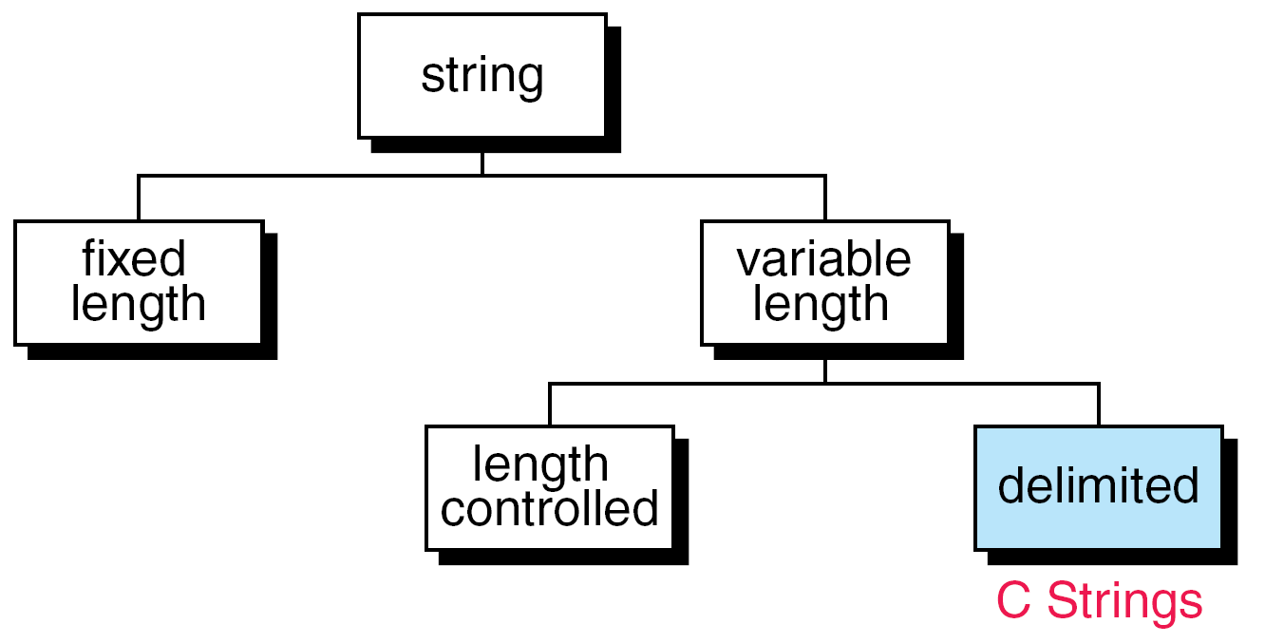
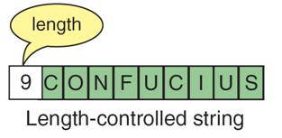
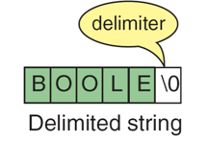
Introduction(contd..)
General - String taxonomy
Strings in Pascal is different from strings in C
Pascal Strings
Length-controlled Strings: stores the number of characters in the string
Delimited Strings: adds a delimiter at the end of string

Slide 8
Strings in C
String is not an explicit type, instead strings are maintained as arrays of characters
Representing strings in C
stored in arrays of characters
array can be of any length
end of string is indicated by a delimiter, the zero character ‘\0’
C uses variable-length, delimited strings.

Slide 9
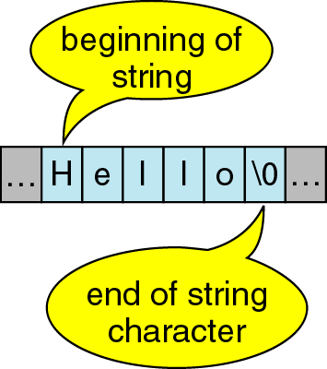
Strings in C - -(contd..)
Strings is a arrays of characters delimited by null character (‘\0’).
“Hello”

Slide 10
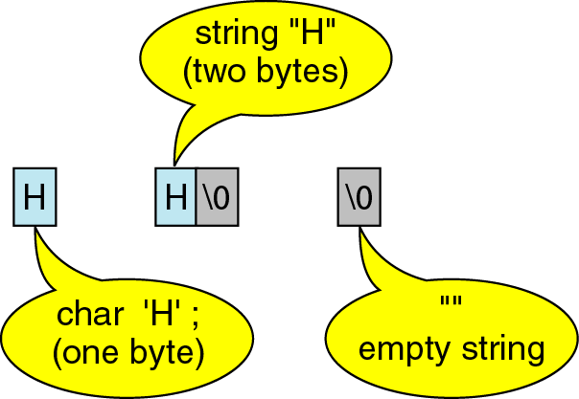
Strings in C (contd..)
Storing strings:
A character, in single quotes:
char s1= `h`; //Takes only one byte of storage.
On the other hand, the character string:
char s2[2]=“H"; //Takes two bytes of storage.
An empty string
char s3[]= “”; //Takes only one byte of Storage storage.
S2
S3
S1

Slide 11
Strings in C (contd..)
String Delimiter:
Strings as we know are data type.
It uses physical structure as arrays
So, it needs a logical end within the physical structure to indicate variable length
Therefore, null character(‘\0’) is used as delimiter
Difference between string and character array is shown in the figure

Slide 12
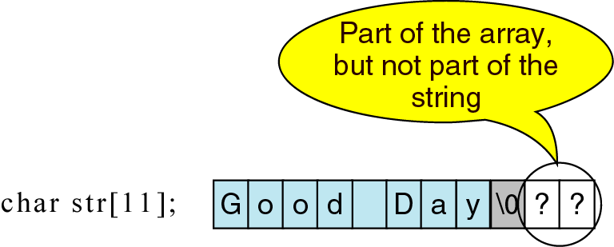
Strings in C (contd..)
String Delimiter:
Important note:
on declaring array take care to leave one byte for delimiter.
String ignores anything that follows null character.

Slide 13
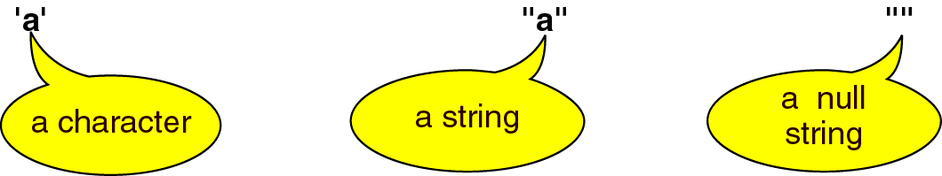
Strings in C – (contd..)
String literals : A string constant or literal is enclosed in double quotes.

Slide 14
Strings in C (contd..)
String Literals:
String literal has an address in memory
String literal is an array of characters, it is a pointer constant to the first element of the string.
Hence, the entire string is referenced using this as shown below..

Slide 15
Strings in C(contd..)
Declaring Strings:
Case (a) has the ceiling of 8-characters plus a delimiter
However, case (b) allows length to be defined before usage.
Memory for strings must be allocated before the string can be used.

Slide 16



Strings in C(contd..)
Initializing Strings:
char str[9]= “Good Day”; or char str[9]= {‘G’,’o’,’o’,’d’,’ ‘, ‘D’,’a’,’y’,’\0’}
char month[]= “January”;
char *pStr =“Good Day”;

Slide 17
Illustration
#include <stdio.h>
int main()
{
char *pstr;
int length;
printf("Enter the length of the string : ");
scanf (“%d”, &length);
pstr = (char *)malloc((length+1)*sizeof(char)); //remember to allocate (length + 1) space
printf("Enter a string : ");
printf("You entered: %s", pstr);
return(0);
}
On execution:
Enter the length of the string: 17
Enter a string : tutorialspoint.com
You entered: tutorialspoint.com

Slide 18
Strings in C(contd..)
Assignment Operator:
The name of the string is a pointer constant.
Pointer constant can be used only as rvalue
hence it cannot be used as left operand of assignment.
char str1[6]=“Hello”;
char str2[6];
Copying strings is done either character-by-character using loops or using library function
str1=str2; gives compilation error

Slide 19
String Input/Output Functions
C provides two basic ways to read and write strings.
First, we can read and write strings with the formatted input/output functions, scanf/fscanf and printf/fprintf.
Second, we can use a special set of string-only functions, get string (gets/fgets) and put string ( puts/fputs ).

Slide 20
String Input/Output Functions (contd..)
Formatted String Input:
Strings can be read using scanf from console and using fscanf from files.
Two Conversion codes are possible for reading strings
String conversion code --- “s”
Scan set conversion code ---- […]
Three optional conversion modifiers are possible preceding the conversion code:
% [*] [maximum-field-width] [size] Letter

Slide 21
String Input/Output Functions (contd…)
Formatted String Input:
Conversion Modifier | Description
Flag (*) | Assignment Supression. This modifier causes the corresponding input to be matched and converted, but not assigned (no matching argument is needed). Eg. int anInt; scanf("%*s %i", &anInt); Matching Input---- Age: 29 Result ---- anInt==29
Maximum-field-width | This is the maximum number of character to read from the input. Any remaining input is left unread. (Always use this with "%s" and "%[...]" in all production quality code! (No exceptions!) You should use one less than the size of the array used to hold the result.) example discussed in following slides.
Size | Read normal 8-bit ASCII characters if not specified. Otherwise, with option l (note it is letter ell) reads wide characters like UCS and Unicode

Slide 22
String Input/Output Functions(contd…)
Formatted String Input – String Conversion Code:
Use %s field specification in scanf to read string
ignores leading white space
reads characters until next white space encountered
C stores null (\0) char after last non-white space char
Example:
char Name[11];
scanf(“%s”, Name); /* Note: need not use & before Name */
Problem: no limit on number of characters read (need one for delimiter), if too many characters for array, problems may occur
The string conversion code(s) skips whitespace.

Slide 23
String Input/Output Functions (contd…)
Formatted String Input – String Conversion Code:
Can use the width value in the field specification to limit the number of characters read:
char month[10];
scanf(“%9s”,month);
Remember, you need one space for the \0
width should be one less than size of array
Strings shorter than the field specification are read normally, but C always stops after reading 9 characters
The remaining part string that is not read upto newline can be/ has to be flushed as shown in the program as follows:

Slide 24
String Input/Output Functions (contd…)
Formatted String Input – String Conversion Code:

Slide 25
String Input/Output Functions (contd…)
Formatted String Input – Scan Set Conversion Code:
Edit set input %[ListofChars]
ListofChars specifies set of characters (called scan set)
Characters read as long as character falls in scan set
Stops when first non scan set character encountered
Note, does not ignored leading white space
Any character may be specified except ]
Putting ^ at the start to negate the set (any character BUT list is allowed)
Examples:
scanf(“%10[-+0123456789]”,Number);
scanf(“%81[^\n]”,Line); /* read until newline char */
scanf(“%15[^~!@#$%^&*()_+]”, str) ; /*reads characters other than specified*/
scanf(“%15 [ ] [0123456789]”,str); /* reads square bracket and num */

Slide 26
String Input/Output Functions (contd…)
Formatted String Input – Scan Set Conversion Code:
Note:
The edit set does not skip whitespace.
Always use a width in the field specification when reading strings.

Slide 27
String Input/Output Functions (contd…)
Formatted String Output:
Strings can be write using printf to console and using fprintf to files.
Conversion codes are possible for writing strings is “s”
Four optional conversion modifiers are possible preceding the conversion code:
% [Justification Flag] [minimum-field-width] [precision] [size] s
The maximum number of characters to be printed is specified by the precision in the format string of the field specification.

Slide 28
String Input/Output Functions (contd…)
Conversion Modifier | Description
Justification Flag | left-justify within the field. Eg. char Name[10] = “Rich”; printf(“|%-10s|”,Name); /* Outputs: |Rich | */
Minimum-field-width | After converting any value to a string, the field width represents the minimum number of characters in the resulting string. If the converted value has fewer characters, then the resulting string is padded with spaces (or zeros) on the left (or right) by default (or if the appropriate flag is used.) Eg. printf( "|%5s|", "ABC"); /* outputs |··ABC| */
Precision | specifies the maximum number of bytes written. If the string is too long it will be truncated. Eg. printf( "|%-5.3s|", "ABCD" ); /* outputs |ABC··| */
Size | Read normal 8-bit ASCII characters if not specified. Otherwise, with option l (note it is letter ell) reads wide characters like UCS and Unicode

Slide 29
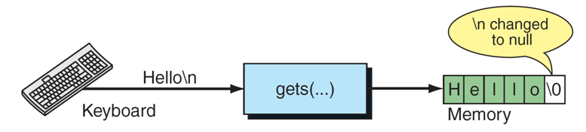
String Input/Output Functions (contd…)
String-only Input :
Read without reformatting any data is provided by the function gets
gets converts line to string
char *gets(char *str)
reads the next line (up to the next newline) from keyboard and stores it in the array of chars pointed to by str
returns str if string read or NULL if problem/end-of-file
not limited in how many chars read (may read too many for array)
newline included in string read

Slide 30
String Input/Output Functions (contd…)
Illustration:
#include <stdio.h>
int main()
{
char str[50];
printf("Enter a string : ");
gets(str);
printf("You entered: %s", str);
return(0);
}
On execution:
Enter a string : tutorialspoint.com
You entered: tutorialspoint.com

Slide 31
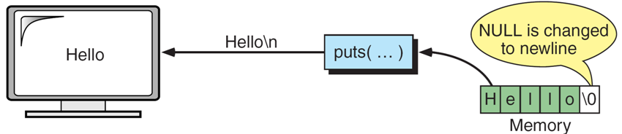
String Input/Output Functions (contd…)
String-only Input:
write without reformatting any data is provided by the function puts
puts converts String to line
int puts(char *str)
prints the string pointed to by str to the screen
prints until delimiter reached (string better have a \0)
returns EOF if the puts fails
outputs newline if \n encountered (for strings read with gets or fgets)

Slide 32

Try it Yourself
Predict the output
#include<stdio.h>
void main() {
char *str="CQUESTIONBANK";
clrscr();
printf(str+9);
getch(); }
What will output when you compile and run the above code?
Answer: BANK

Slide 33
Try it Yourself
Predict the output
What will be output when you will execute following c code?
#include<stdio.h>
void main(){
char arr[7]="Network";
printf("%s",arr);
}
Answer: garbage value (Reason: as the string “Network” is of length 7 so the string is not null terminated)

Slide 34
Try it Yourself
Predict the output
What will be output when you will execute following c code?
#include<stdio.h>
#define var 3
void main(){
char *cricket[var+~0]={"clarke","kallis"};
char *ptr=cricket[1+~0];
printf("%c",*++ptr);
}
Answer: l
Reason:
In the expression of size of an array can have micro constant. var +~0 = 3 + ~0 = 3 + (-1) = 2
Therefore circket[2] = {pointer to c, pinter to k}
++ptr --- ptr+1 is equal to the location following c in clarke, hence th answer is l(letter ell).

Slide 35
Summary
The string storage schemes in old styled programming language vs new languages were discussed.
Declaring and initializing strings was discussed.
Raw vs formatted read and write of strings was dealt .

